Slide 1
IPRO Community Based Sepsis:
Sepsis Awareness for Physician Practices
Train-the-Trainer Program
What You Don’t Know Could Kill You!
September 11, 2024
Sara Butterfield RN, BSN, CPHQ
Assistant Vice President, Healthcare Quality Improvement Program / IPRO QIN-QIO
This material was prepared by the IPRO QIN-QIO, a Quality Innovation Network-Quality Improvement Organization, under contract with the Centers for Medicare & Medicaid Services (CMS), an agency of the U.S. Department of Health and Human Services (HHS). Views expressed in this material do not necessarily reflect the official views or policy of CMS or HHS, and any reference to a specific product or entity herein does not constitute endorsement of that product or entity by CMS or HHS. Publication # 12SOW-IPRO-QIN-T1-A2-23-988

Slide 2

Thank you for your continued efforts to keep your patients and community safe

Slide 3
Learning Objectives
Identify the incidence, mortality rates and risk factors associated with community-based sepsis.
Discuss the signs and symptoms of sepsis, the importance of early recognition and established protocols for emergent treatment.
Discuss the importance of sepsis protocols in the physician practice setting.
Review the components of the IPRO Stop Sepsis Now Campaign and tools and resources to support you, your family and friends, the patients under your care and the community you serve.

Slide 4
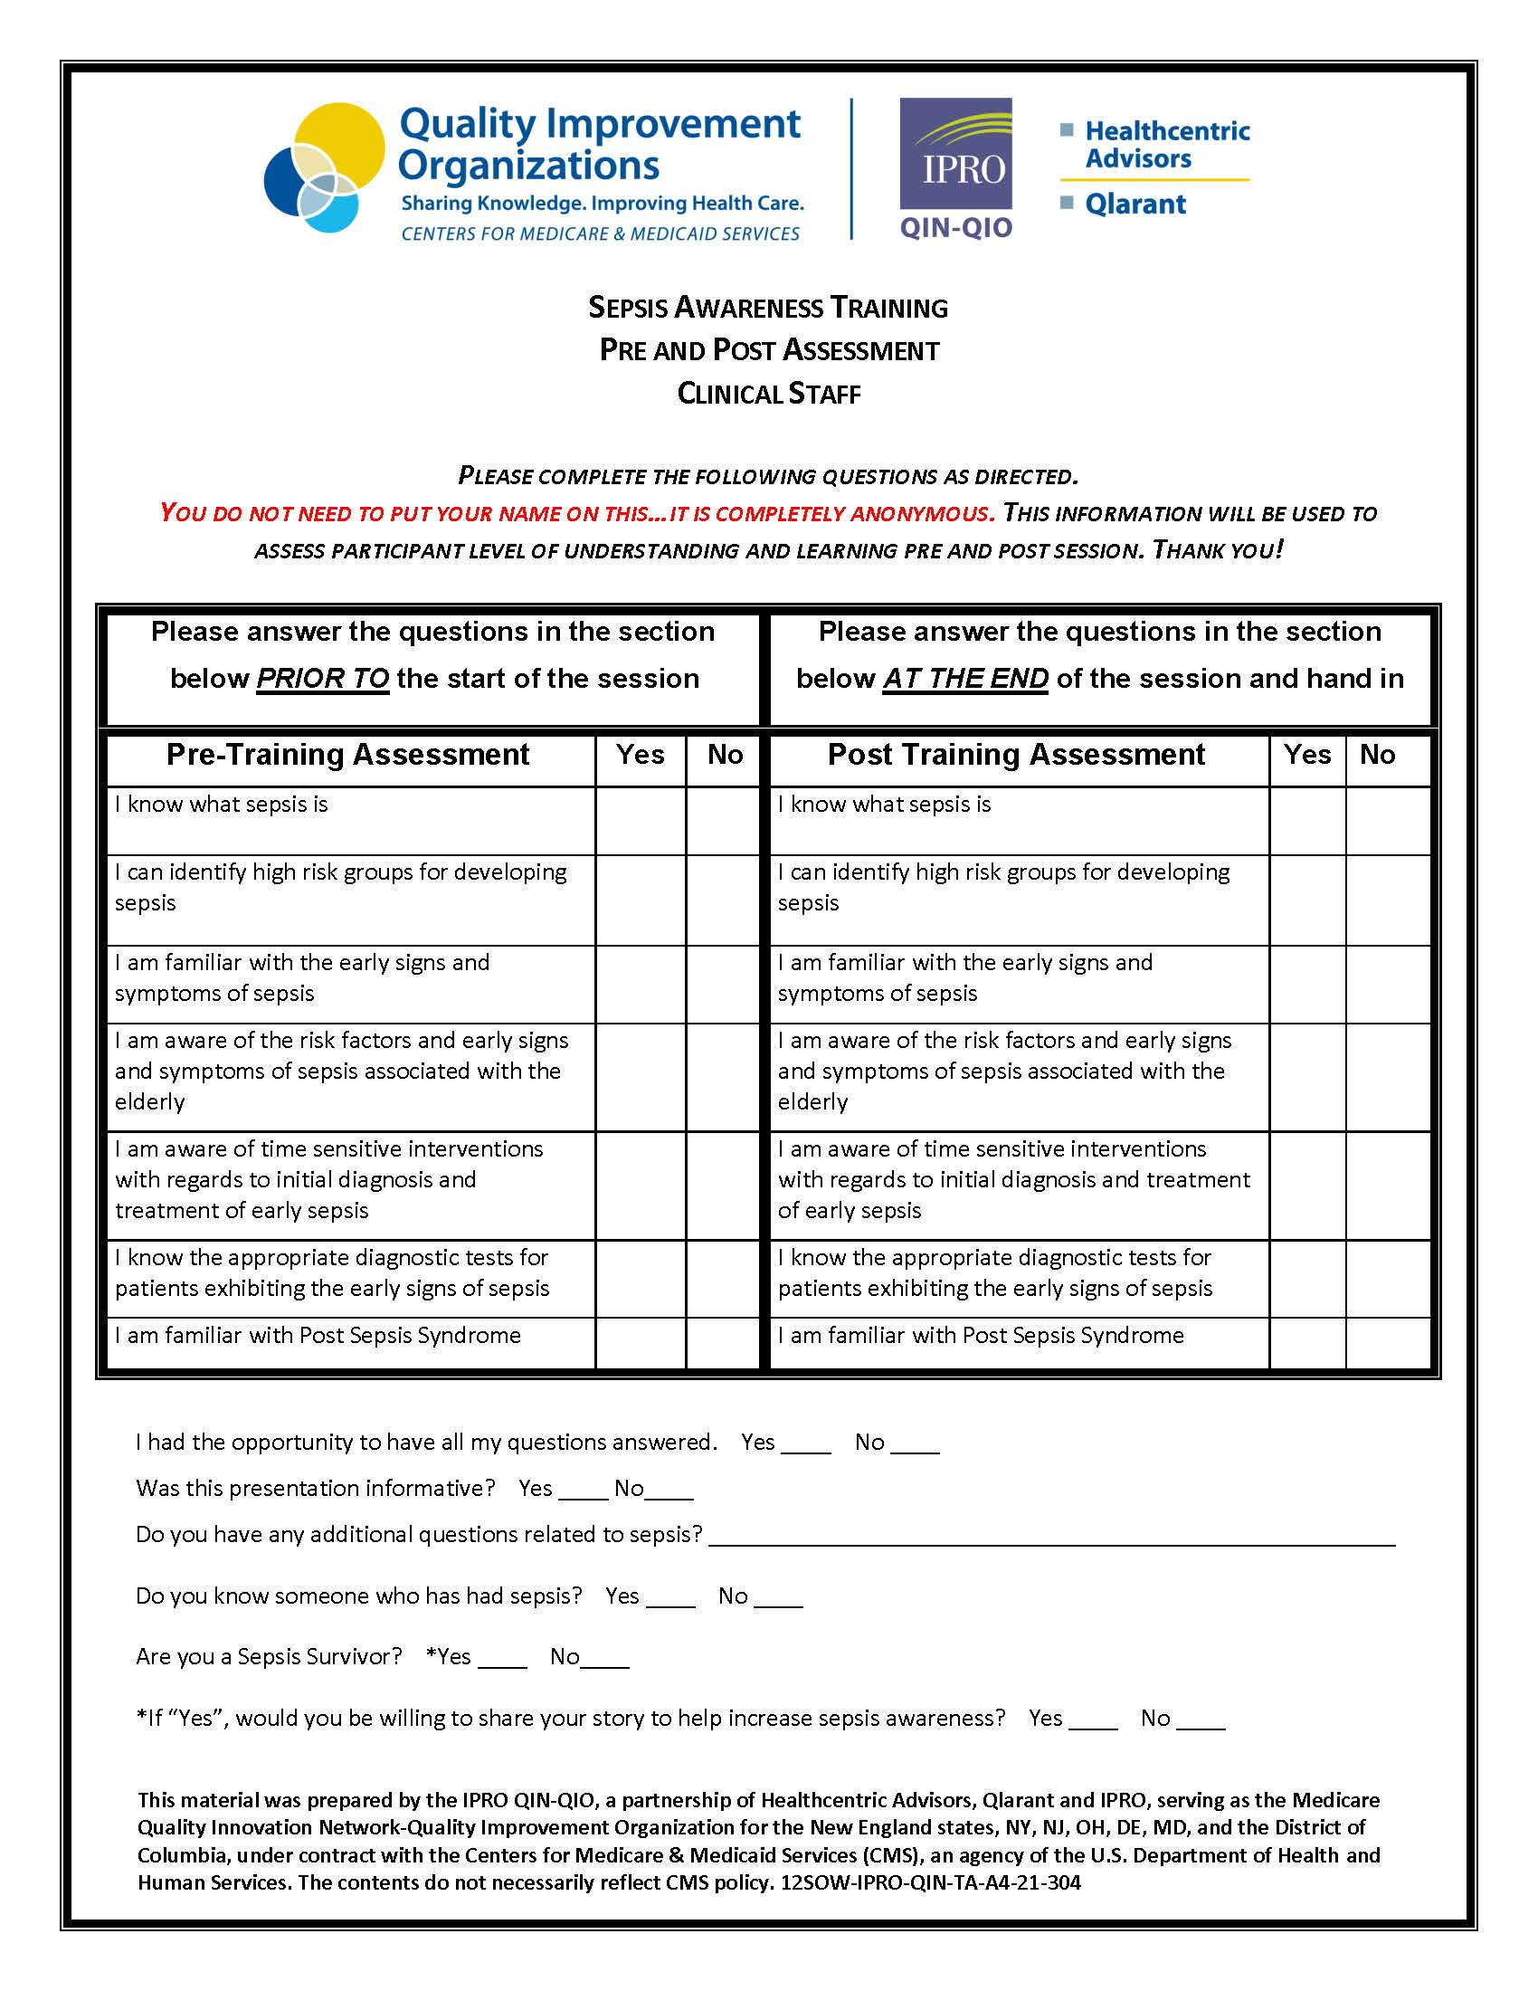
Please complete the
Pre-Training
Assessment questions prior to the start of the training session, thank you!
IPRO Sepsis Initiative
https://qi.ipro.org/sepsis/

Slide 5

Sepsis
Sepsis is a life-threatening condition that arises when the body’s response to an infection injures its own tissues and organs¹
Sepsis is a leading cause of death and
healthcare spending globally ^{2,3}
  Singer, et al. JAMA 2016;315(8) 801-810
  Fleischmann, et al. Am J Resp Crit Care Med. 2016; 193:259-272
  Iwashyna, et al. J Am Geriatr Soc. 2012;60:1070-1077
Notes:
Read brief paragraph about Sepsis Alliance.
The video you are about to view is very powerful and a compelling call to action.

Slide 6
Why Focus on Community Based?
> 87% of sepsis cases originate in the community₁
Sepsis mortality is largely preventable with early detection and appropriate treatment
Just 58% of U.S. adults have heard of sepsis ₂
Sepsis diagnosis often missed by healthcare providers
Sepsis is the #1 reason for 30-day hospital readmissions
Sepsis Alliance
Sepsis Allaince
Notes:
Treatment for Sepsis is typically done in a hospital (either in the ED or as an in-patient)

Slide 7
Sobering Statistics
  Sepsis causes 270,000 deaths and $38 billion spent annually in hospitals₁
  In-hospital mortality rate 8Xs higher than other diagnoses
Sepsis accounts for more than 50% of hospital deaths , and mortality increases dramatically with greater disease severity: 10–20% for sepsis, 20–40% for severe sepsis, and 40–80% for septic shock ₂
18 million people die of sepsis worldwide every year ₃
Sepsis is the leading cause of childhood deaths ₄
Sepsis is the most expensive condition treated in U.S. hospitals ₅
Early diagnosis of sepsis is often missed ₆
    National Institutes of Health (NIH) 2023
    JAMA 2014
    Crit Care Med 2001
    AHRQ
    CDC
    Sepsis Alliance
Notes:
In fact, in a recent national survey, it was revealed that barely half of all Americans have heard of the term Sepsis. There is a lot of opportunity to educate and increase awareness about sepsis in the community and understanding that it needs to be treated as a medical emergency

Slide 8
Sepsis Awareness is Poor
Sepsis is one of the most under recognized and misunderstood conditions by healthcare providers and the public
The public needs an understandable definition of sepsis
Public needs to know the signs and symptoms of sepsis and associate sepsis as a medical emergency
Clinical prompts for healthcare providers facilitate earlier identification of sepsis

Slide 9


Time to Treatment is Critical
Mortality increases by 8% for every hour that appropriate treatment is delayed
    Organ Failure
    Tissue Damage
    Death
Early identification and treatment are the keys to improved outcomes
Notes:
There are simple things that can minimize the risk of developing sepsis

Slide 10
In New York, over 50% of in-hospital mortality due to septicemia or severe sepsis in Medicare beneficiaries being transferred to the hospital by a nursing home facility prior to their admission, occurs within the first 6 days after admission.
New York State Medicare Fee-For-Service Beneficiaries referred to the hospital from a SNF/ICF or health facility transfer, who did not receive Home Health Care prior to admission.
Time frame: 1/1/2022 – 12/31/2022, Medicare Fee-for-Service Part A Claims
Sepsis Hospitalizations identified through: Sepsis Primary Diagnosis was present on admission. Source of Admission to Hospital was a Physician or Clinic Referral. Facility Transfers are Excluded. Patient Disposition was Expired.

Slide 11
In New York, 50% of in-hospital mortality due to septicemia or severe sepsis in Medicare beneficiaries receiving Home Health Care prior to their admission, occurs within the first 5 days after admission.
QIN-QIO Medicare Fee-For-Service Beneficiaries who Received Home Health Care Prior to Admission
Time frame: 1/1/2022 – 12/31/2022, Medicare Fee-for-Service Part A Claims
Sepsis Primary Diagnosis was present on admission. Source of Admission to Hospital was a Physician or Clinic Referral. Facility Transfers are Excluded. Patient Disposition was Expired.

Slide 12
In New York, 50% of in-hospital mortality due to septicemia or severe sepsis in Medicare beneficiaries being referred directly to the hospital by a physician or clinic prior to their admission, occurs within the first 6 days after admission.
New York State Medicare Fee-For-Service Beneficiaries referred to the hospital from a physician or clinic, who did not receive Home Health Care prior to admission.
Time frame: 1/1/2022 – 12/31/2022, Medicare Fee-for-Service Part A Claims
Sepsis Primary Diagnosis was present on admission. Source of Admission to Hospital was a Physician or Clinic Referral. Facility Transfers are Excluded. Patient Disposition was Expired.

Slide 13

Approach
  Educate: Sepsis is a Medical Emergency
  Improve sepsis care transitions between pre-hospital, acute care and post-acute healthcare and community settings
  Focus education on high-risk populations and the community
  Educate all levels of staff on early recognition of sepsis in the community
  Educate patients, families and care partners on signs and symptoms of sepsis
Notes:
Although much of the information in the upcoming slides was addressed in the video, the important messages about recognizing sepsis as a medical emergency and familiarizing yourself with the early warning signs certainly bear repeating

Slide 14

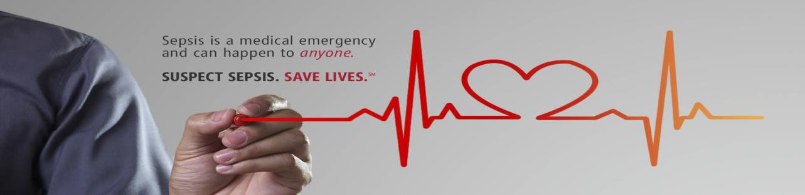
Identification of Sepsis

Slide 15
Sepsis and Infection
Sepsis is always triggered by an infection
Sometimes people don’t know they have an infection
Sometimes the causative agent of the infection is not identified
Sepsis diagnosis is sometimes missed due to various manifestations of sepsis
Conversely: If symptoms of sepsis exist, a source of infection should be sought
Notes:
Read brief paragraph about Sepsis Alliance.
The video you are about to view is very powerful and a compelling call to action.

Slide 16
Who is at Risk for Sepsis?
Anyone with an infection!
Those at higher risk for developing sepsis include:
    People 65 or older
    Infants less than 1 year old
    People with chronic illnesses: diabetes, cancer, AIDS
    People with weakened immune systems
    People recently hospitalized
    People recovering from surgery
    People who have had sepsis in the past
Notes:
Treatment for Sepsis is typically done in a hospital (either in the ED or as an in-patient)

Slide 17
Sepsis Facts
Bacterial infections cause most cases of sepsis
Viral (COVID, Influenza) and fungal (Candida) infections can also cause sepsis
At least 350,000 adults who develop sepsis die during their hospitalization or are discharged to hospice
Sepsis related deaths increased with age among adults aged 65 or over
1 in 3 people who die in a hospital had sepsis during that hospitalization
Anyone can develop sepsis, the following groups of people are at higher risk; adults 65 or older, people with weakened immune systems, people with chronic medical conditions (diabetes, lung disease, cancer, kidney disease), people with recent severe illness or hospitalization, people who survive sepsis.
https://www.cdc.gov/nchs/products/databriefs/db422.htm
https://www.cdc.gov/sepsis/what-is-sepsis.html

Slide 18
Early Signs of Sepsis
Sepsis always develops from a confirmed or suspected infection
with more than one of the following:
  Fever, shivering, feeling very cold
  Cool extremities or mottling of skin
  Rapid heart rate
  Rapid breathing
  Shortness of breath
  Confusion or difficult to arouse
  Complaints of extreme pain
  Pale/discolored skin
  Clammy sweaty skin
Notes:
Read brief paragraph about Sepsis Alliance.
The video you are about to view is very powerful and a compelling call to action.

Slide 19
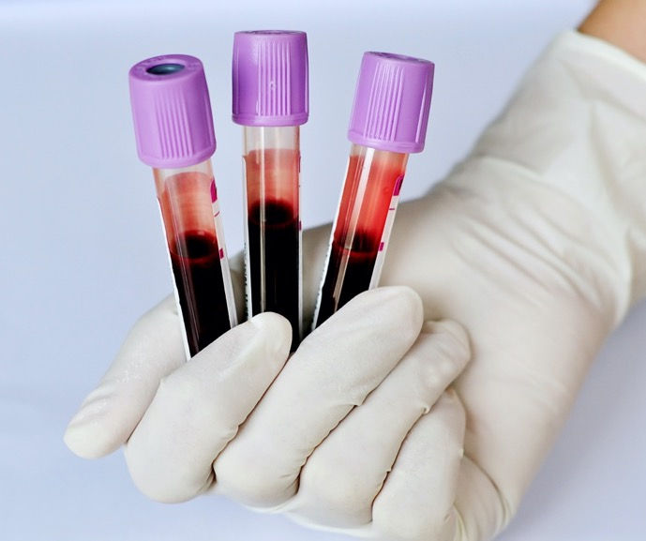
Other Early Signs May Include…
Decreased blood pressure
    (SBP <90mmHg or SBP decrease>40mmHg)
Other signs of altered mental status
Decreased urine output / dark, concentrated urine
Abnormal lab tests
      Increased lactate level
      Increased creatinine
      Decreased platelet count
      Coagulation abnormalities
      Hyperglycemia in absence of diabetes
Notes:
Treatment for Sepsis is typically done in a hospital (either in the ED or as an in-patient)

Slide 20

Common Infectious Diseases That May Progress to Sepsis
Pneumonia
Skin Infections (cellulitis)
Urinary Tract Infections
Post-partum Endometritis
Influenza
Clostridioides difficile (C.diff) Enteritis
Tick-borne Infections especially in the immunocompromised
Notes:
Treatment for Sepsis is typically done in a hospital (either in the ED or as an in-patient)

Slide 21
Considerations for the Elderly
Elderly constitute 1/5 of the US population but 2/3 of patients admitted to the hospital with sepsis¹
Risk factors specific to this demographic
  Increased incidence of chronic co-morbidities²
  Prone to UTIs- a common source of sepsis
  Malnutrition is common in the elderly³
  Increased incidence of colonization by drug resistant bacteria ⁴
  Declining immune functionality (more susceptible to infections)
  Crit Care Med. 2006;34:15-21
  Crit Care Med. 2007;35:1244-1250
  North Am. 2001;30:313-334
  N Engl J Med. 1978;298:1108-1111

Slide 22
2012 Definitions for Sepsis
Systemic Inflammatory Response Syndrome (SIRS)
SIRS is nonspecific and can be caused by: infection, inflammation, trauma, ischemia or several insults combined
SEPSIS = INFECTION + 2 OR MORE SIRS CRITERIA
SIRS Criteria:
  Fever >101°F
  Hypothermia <96.8°F
  Heart rate >90 beats/minute
  Respiratory rate >20 breaths/minute
  WBC >12 or <4 or >10% bands
  Note: SIRS can exist without progressing to sepsis
Notes:
Sepsis always develops from an infection

Slide 23
Progression of Sepsis
If not treated promptly, sepsis can progress!
INFECTION + 2 or more SIRS criteria
  SEPSIS
  SEPSIS + NEW ONSET ORGAN INJURY
  SEVERE SEPSIS
  SEVERE SEPSIS + REFRACTORY HYPOTENSION
  OR TISSUE HYPOXIA (ELEVATED LACTATE)
  SEPTIC SHOCK
Notes:
Knowing the early signs and symptoms of sepsis could help you save the life of a friend, co-worker, family member, loved one or yourself

Slide 24
2016 Definitions for Sepsis
  Third International Consensus Definitions for Sepsis and Septic Shock
  (Singer, et al. JAMA 2016;315(8) 801-810)
  Utilizes SOFA criteria: Sequential Organ Failure Assessment Score
qSOFA (Quick SOFA) Criteria:
  Better predictor of patient outcomes for non-hospital and non-ICU settings
  (vs. SIRS criteria)
  Appropriate and easy to use in the outpatient setting
  2 of the 3 criteria provides simple bedside criteria to identify adults with suspected infection who are likely to have poor outcomes
    Altered mental status
    Hypotension ( systolic <100mmHg)
    Increased respiration rate (>22 breaths per minute)
Notes:
Sepsis always develops from an infection

Slide 25


Initial Treatment Evidence Based
Consistent with Centers for Medicaid & Medicare Services: Management Bundle
Within 3 Hours of Presentation*
    Measure blood lactate level
    Obtain blood cultures (prior to giving antibiotics)
    Administer broad-spectrum IV antibiotics
    Administer 30ml/kg crystalloid for hypotension or lactate≥4mmol/L
      Recommended within 1st hour of recognition
Within 6 Hours of Presentation of Septic Shock
    Administer vasopressors (for hypotension that does not respond to initial fluid resuscitation) to maintain a mean arterial pressure (MAP) ≥65mmHg
    For persistent hypotension (MAP<65) or initial lactate ≥4mmol/L, reassess volume status and tissue perfusion
    Repeat lactate level if initial level was elevated
*Time of presentation is defined as the time of triage in the emergency department or, if presenting from another care venue, from the earliest chart annotation consistent with all the elements of severe sepsis or septic shock ascertained through chart review
Notes:
Sepsis always develops from an infection

Slide 26
Hour - 1 Bundle
Surviving Sepsis Campaign
Sepsis and septic shock are leading causes of death worldwide. Implement the Surviving Sepsis Campaign guidelines and the Hour-1 Bundle and be part of the international effort to reduce mortality and morbidity. Guidance for children is now also available.
Medical Emergency:
Initiate bundle upon reconciliation of sepsis/septic shock. May not complete all bundle elements within one hour of recognition.
Measure lactate level, re-measure lactate if initial lactate elevated (>2mmol/L)
Obtain blood cultures before administering antibiotics
Administer broad-spectrum antibiotics
Begin rapid administration of 30 mL/kg crystalloid for hypotension or lactate> mmol/L
Apply vasopressors if hypotensive during or after fluid resuscitation to maintain a mean arterial pressure > mm Hg
https://www.sccm.org/SurvivingSepsisCampaign/Home

Slide 27
Antibiotic Stewardship versus Treating Sepsis
Not a Conflict in Strategies!
Stressed in all Training and Community Outreach Events
Urgent antibiotic therapy is needed for bacterial infections to prevent progression to sepsis and septic shock
Growing focus on appropriate use of all antibiotics both in and out of the hospital
Discourage empiric prescribing for upper respiratory tract infections and non-specific febrile and viral syndromes

Slide 28
Hospitalizations for Sepsis Increasing
  Increase in aging population (high-risk group)
  Increase in antibiotic resistant bacteria
  Increase in people with immunocompromising conditions

Slide 29
Patients Hospitalized for Sepsis
Are more severely ill than those hospitalized for other conditions
Have considerably longer lengths of stay in the hospital than those hospitalized for other conditions (median=10 days)¹
Are more likely to die during hospitalization compared to those hospitalized for other conditions
1. MMWR Vol.65 Aug.2016
Notes:
It is important educate people not to ignore these initial signs of sepsis.

Slide 30
Sepsis-Associated Delirium
Confusion, agitation, coma
Occurs in one in every three to four patients with sepsis
Mechanisms not completely understood, but neuroinflammation, altered blood flow and neurotransmission, and disruption of blood-brain barrier have been demonstrated
Impairment can persist for months or longer
Screening tools essential to early detection and treatment
Avoid use of psychoactive drugs in management
Atterton, B., Paulino, M. C., Povoa, P., & Martin-Loeches, I. (2020). Sepsis Associated Delirium. Medicina, 56(5), 240. https://doi.org/10.3390/medicina56050240

Slide 31
Post Sepsis Syndrome
Affects up to 50% of sepsis survivors
Post-sepsis syndrome is a condition that can result in physical and/or psychological long-term effects, such as:
    Impaired cognitive function-especially among older patients
    Mobility impairments (muscle weakness)
    Amputations
    Hallucinations
    Loss of self-esteem
    Increased dependency on others
    *Higher risk for patients with an ICU or extended hospital stay
Significant Impact on Caregivers
    Inadequate hospital discharge education on what to expect during recovery
    Difficulty accessing follow-up community treatment
    Cost
    Disruption to their lives

Slide 32
Sepsis and Readmission
Study of Medicare beneficiaries found that those who survived hospitalization for sepsis, 40% were readmitted within 90 days
Patients discharged after treatment for sepsis have high rates of hospital readmissions for chronic medical conditions (CHF, COPD, Acute Renal Failure)
Patients > 65 years of age- reasons for readmission within 90 days
  1.8% readmitted for aspiration pneumonia
  11.9% readmitted for infection (sepsis, pneumonia, urinary tract infection and skin and soft tissue infection.
  5.5% readmitted for CHF
  3.3% readmitted for acute renal failure
Enhancing Recovery from Sepsis; JAMA 2018; 319: 62-75

Slide 33
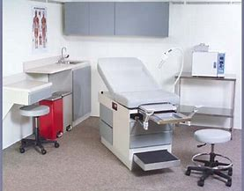
Relevance to the Primary Care Setting
Among all patients with sepsis, 72% had either a health care factor in the month preceding admission or a chronic condition likely to require frequent contact with the health care system, suggesting that opportunities exist for prevention or earlier recognition of infections leading to sepsis. ₁
The biggest delay in treating sepsis still is diagnosis. ₂
Primary care setting provides opportunities for sepsis prevention:
    Vaccinations
    Wound care education
    Sepsis education to high-risk individuals
    Chronic disease management
CDC MMWR Weekly / August 26, 2016
Sepsis Alliance

Slide 34
Relevance to the Primary Care Setting
If Sepsis suspected facilitate report and triage to hospital for resuscitation/antibiotics
Use of telemedicine for patients at high-risk for clinical deterioration to facilitate monitoring of possible transition from infection to sepsis
Institute training and screening protocols for upfront patient facing staff handling phone calls from patients/families requesting an appointment
  Signs & symptoms to escalate to Nurse/Physician emergently
  Follow-up to ensure patient/family followed guidance for screening if in ED
Home Care Association of NYS Adult Sepsis Screening Tool (Stop Sepsis At Home - HCA-NYS)
  Screening tool instrument, algorithm, standard protocol, and patient education Zone Tool

Slide 35
Sepsis Web-based Training & Resources

Slide 36
Sepsis Patient Education
Simple measures you can take:
        Practice good hand hygiene
        Try to avoid infections
        Treat infections promptly
        Get vaccinated!
        Maintain good overall health
Share & introduce the IPRO brochure
“Sepsis: Every Minute Counts!”
IPRO Sepsis Initiative
https://qi.ipro.org/sepsis/
English & Spanish
Notes:
Treatment for Sepsis is typically done in a hospital (either in the ED or as an in-patient)

Slide 37
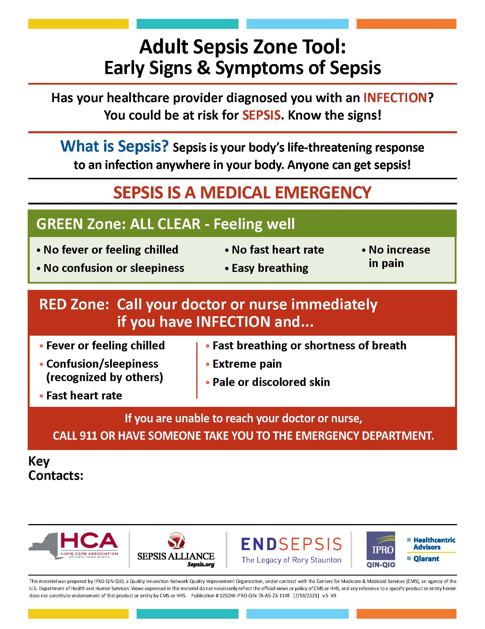
IPRO Adult Sepsis Zone Tool
English and Spanish
Patient information sheet to self-monitor for the early signs and symptoms of sepsis
Provide this for residents that have either been diagnosed with an infection or are at high risk for developing an infection
IPRO Sepsis Initiative
https://qi.ipro.org/sepsis/

Slide 38
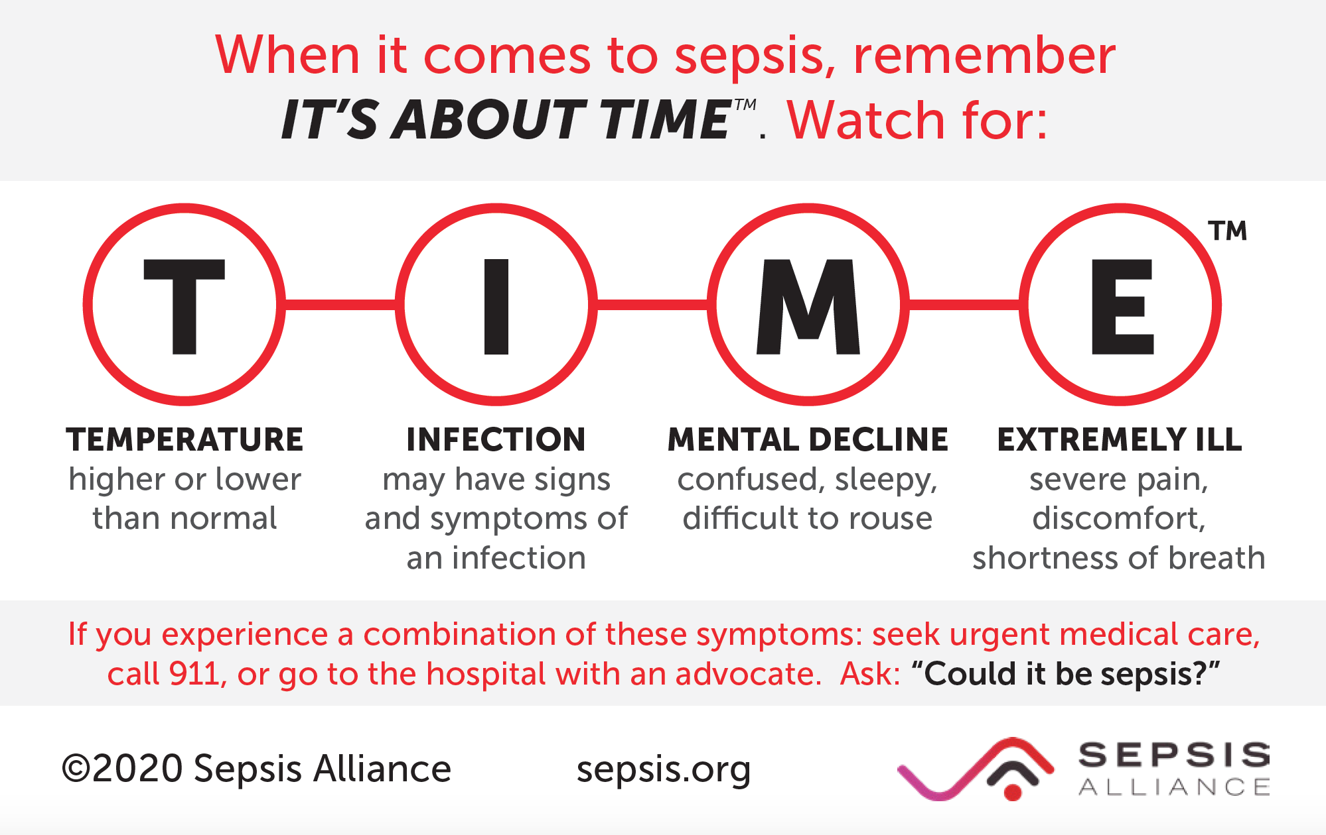
Sepsis

Slide 39
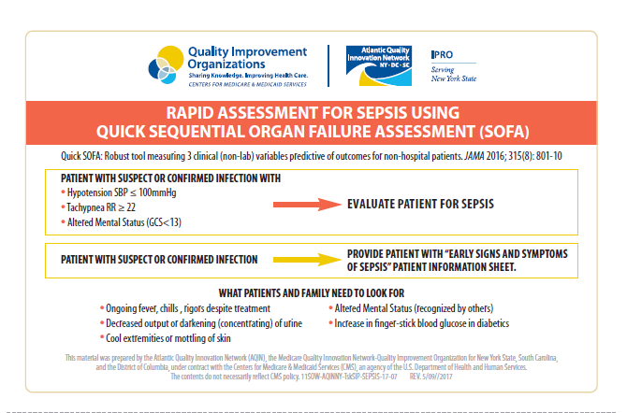
Quick Reference for Clinicians
IPRO will provide laminated Rapid Assessment Guides to physician offices
They can be posted in exam rooms for quick reference

Slide 40


Slide 41
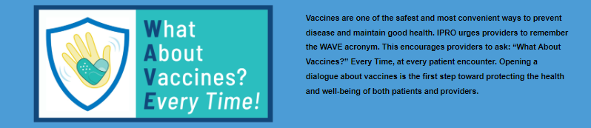
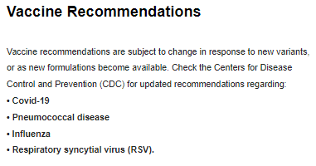
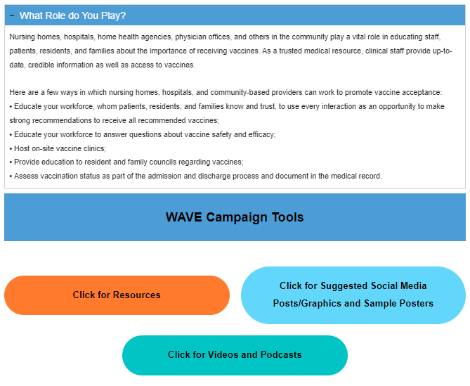
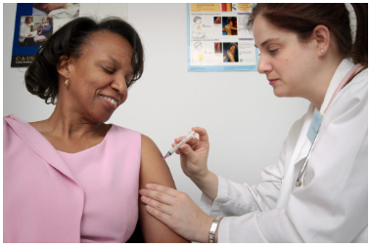
https://qi.ipro.org/home/what-about-vaccines-at-every-encounter/

Slide 42
Infection Prevention
Hand hygiene
Limit use of urinary catheters
Pneumococcal, influenza, COVID vaccination
Prompt identification and isolation of residents with viral respiratory illness
Tuberculosis screening
Antibiotic stewardship
Employee health
Outbreak containment protocols
Infection control policies and procedures
Smith, P. W., Bennett, G., Bradley, S., Drinka, P., Lautenbach, E., Marx, J., Mody, L., Nicolle, L., & Stevenson, K. (2008). SHEA/APIC Guideline: Infection prevention and control in the long-term care facility. American Journal of Infection Control, 36(7), 504–535. https://doi.org/10.1016/j.ajic.2008.06.001

Slide 43
How You Can Help
Familiarize yourself with the early signs of sepsis
Know who is at high risk for sepsis
Educate residents, family, friends and loved ones about the signs & symptoms of sepsis
Be cognizant of health literacy and its implications:
    Explain information to patients in a manner they can understand
        Teach Back Method

Slide 44
Please complete Post Training Assessment questions and hand in to presenter at the end of training session
Thank you!
IPRO Sepsis Initiative
https://qi.ipro.org/sepsis/

Slide 45

Our Ask…..Please Go Forth & Train!
In Order To……….
Maximize the information learned today
Improve staff knowledge on sepsis
Promote early identification of sepsis in residents
Achieve improve health outcomes related to sepsis
Our Ask…….
Conduct at least one Sepsis Training for clinical staff & one for non-clinical staff within your practice

Slide 46

Every Minute Counts!
TREAT SEPSIS AS A MEDICAL EMERGENCY
NOTIFY PHYSICIAN ASAP IF RESIDENT EXHIBITS THE SIGNS OF SEPSIS
Sepsis is treatable and can be prevented from progressing to septic shock…BUT it must first be suspected!
Early, prompt recognition and treatment improves survival rates
1. Crit Care Med,2006; 34: 1589-96.
Notes:
Sepsis can progress very quickly, so prompt medical attention is extremely important in preventing sepsis related complications and even death

Slide 47

Sepsis Alliance Sepsis: Emergency Video
Sepsis: Emergency Video Available on Sepsis Alliance Website: https://www.sepsis.org
Notes:
The video you are about to view is very powerful and a compelling call to action.

Slide 48


Questions / Feedback

Slide 49
IPRO Sepsis Train-the Trainer Content Outline
Sepsis Alliance video “SEPSIS: EMERGENCY”
Identification of high-risk populations
Evidence supporting community-based sepsis awareness
Recognizing early signs/symptoms
Treatment strategies
SNF Care Pathway
Sepsis Self Management Tool
Post sepsis syndrome
Preventative measures
Facility based training process
Please Go Forth & Share/Train !
Notes:
Read brief paragraph about Sepsis Alliance.
The video you are about to view is very powerful and a compelling call to action.

Slide 50




What are you going to do by next Tuesday?
Discuss within Practice current protocols
Share Sepsis Zone Tool with patients, families
and care givers
Schedule clinical & non-clinical staff training
Encourage staff to discuss with their family & friends to increase sepsis awareness
Add “History of Sepsis” to intake screening process

Slide 51
Resources
CDC “Get Ahead of Sepsis Campaign”:
https://www.cdc.gov/sepsis/get-ahead-of-sepsis/index.html
Sepsis Alliance:
http://www.sepsis.org/
Rory Staunton Foundation:
https://www.patientcarelink.org/the-rory-staunton-foundation-for-sepsis/
IPRO Sepsis Initiative
http://stopsepsisnow.org
Surviving Sepsis Campaign:
http://www.survivingsepsis.org/Pages/default.aspx

Slide 52


Learn More & Stay Connected
https://qi.ipro.org/
Follow IPRO QIN-QIO
This material was prepared by the IPRO QIN-QIO, a Quality Innovation Network-Quality Improvement Organization, under contract with the Centers for Medicare & Medicaid Services (CMS), an agency of the U.S. Department of Health and Human Services (HHS). Views expressed in this material do not necessarily reflect the official views or policy of CMS or HHS, and any reference to a specific product or entity herein does not constitute endorsement of that product or entity by CMS or HHS. Publication # 12SOW-IPRO-QIN-T1-A2-23-988
Notes:
Host: You can connect with us for assistance and additional tools through our website. We encourage you to visit our Resource Library and will share the direct link to the library in chat. Next slide please.

Slide 53
Contact Information
Sara Butterfield, RN, BSN, CPHQ
Assistant Vice President, Healthcare Quality Improvement Program
IPRO
518-320-3504
sbutterfield@ipro.org
IPRO Stop Sepsis Now
https://qi.ipro.org/sepsis/

